Slide 1
Instagram_LITE : A Swift-Based Social App
Presented by
Md.Ahanaf Tahmid
2007097
S M Shible Sadik
2007120
Anik Ekka 2007121

Slide 2
Key Features
Sign Up
Log In
Feed
Profile View
Edit Profile
Upload Post
Search User
Shop list

Slide 3
INTRODUCTION
This project is a working Instagram Lite for iOS. It includes key features like user signup, login, photo sharing, search user and show feed.
Built with Swift and SwiftUI, it uses Firebase for storing data and user authentication.
The app provides a smooth experience with clean design and simple animations. This project shows skills in iOS development, app design, and cloud integration.

Slide 4
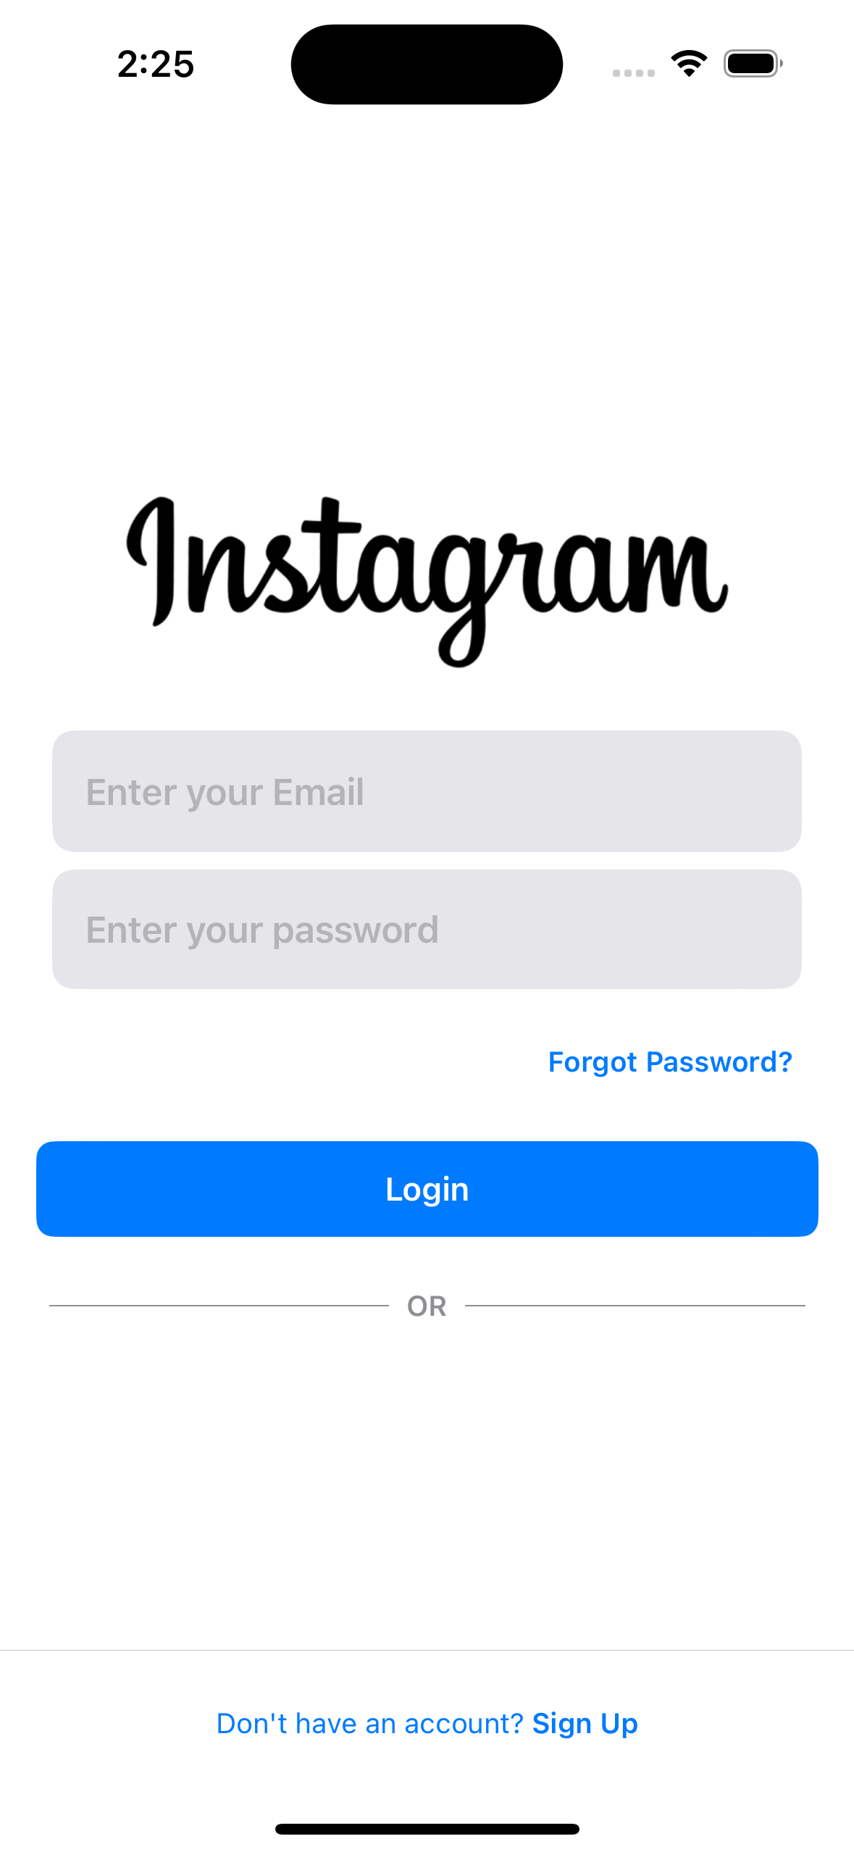
User Sign Up
The user sign-up process is handled using Firebase Authentication.
Users can sign up by providing their email and setting a secure password.
Once the sign-up is successful, users are prompted to create a unique username

Slide 5
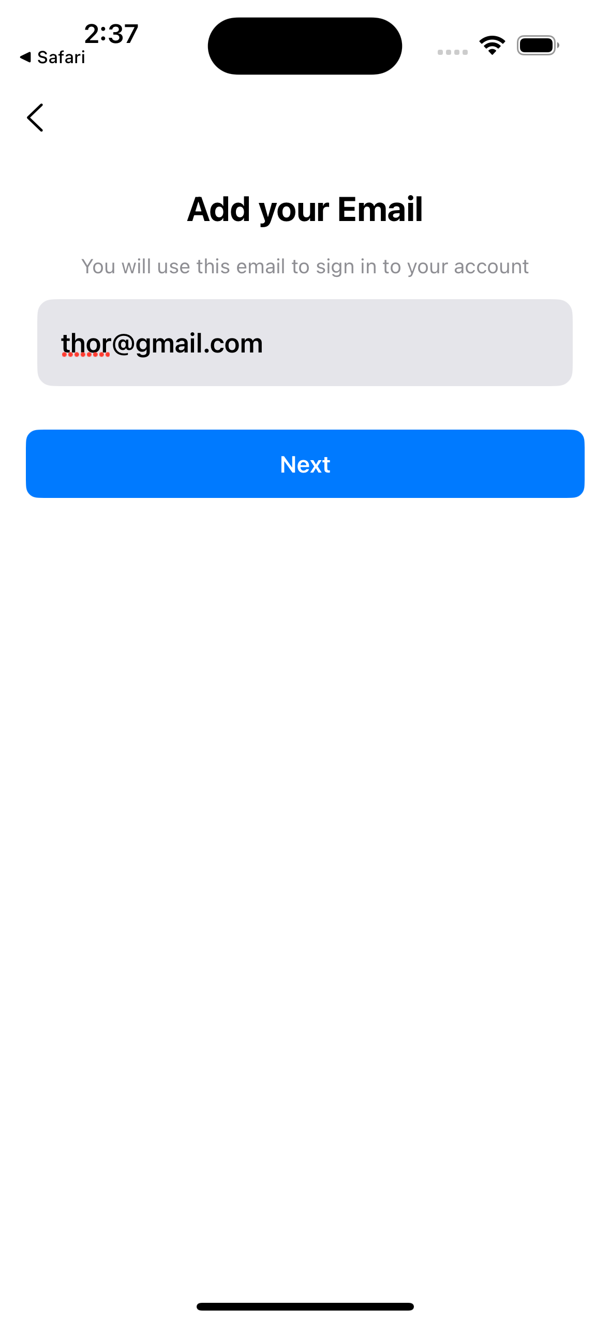
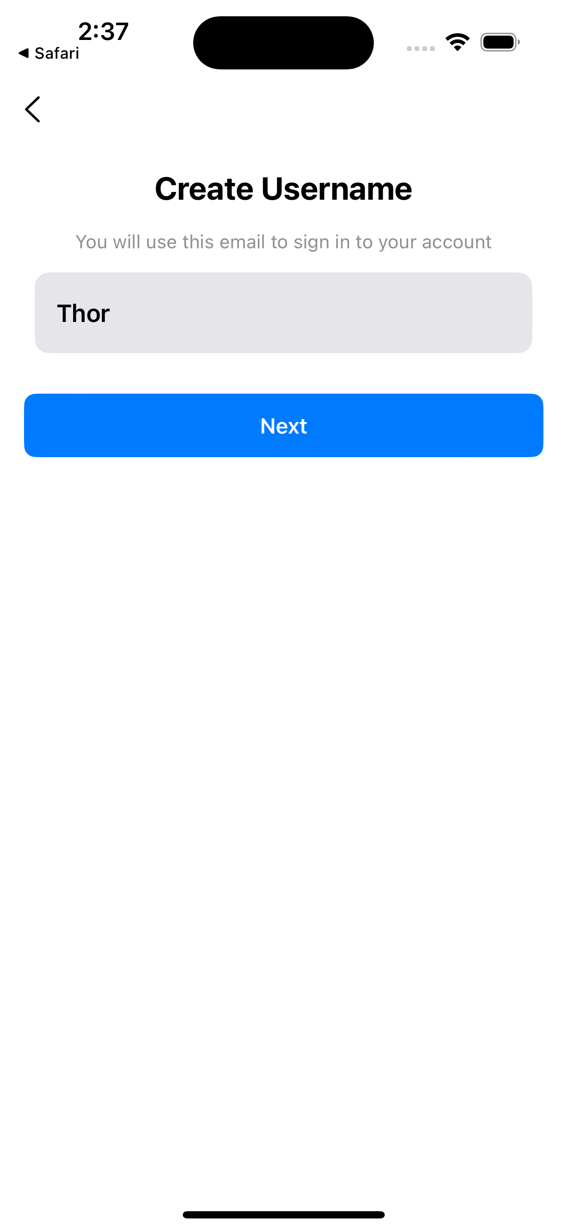
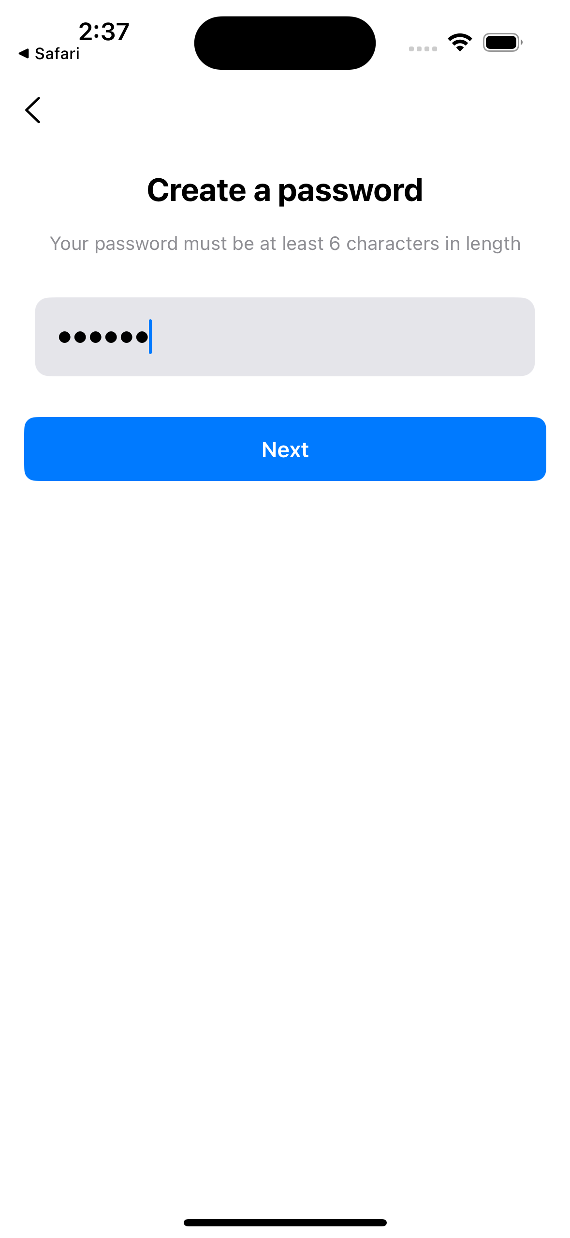
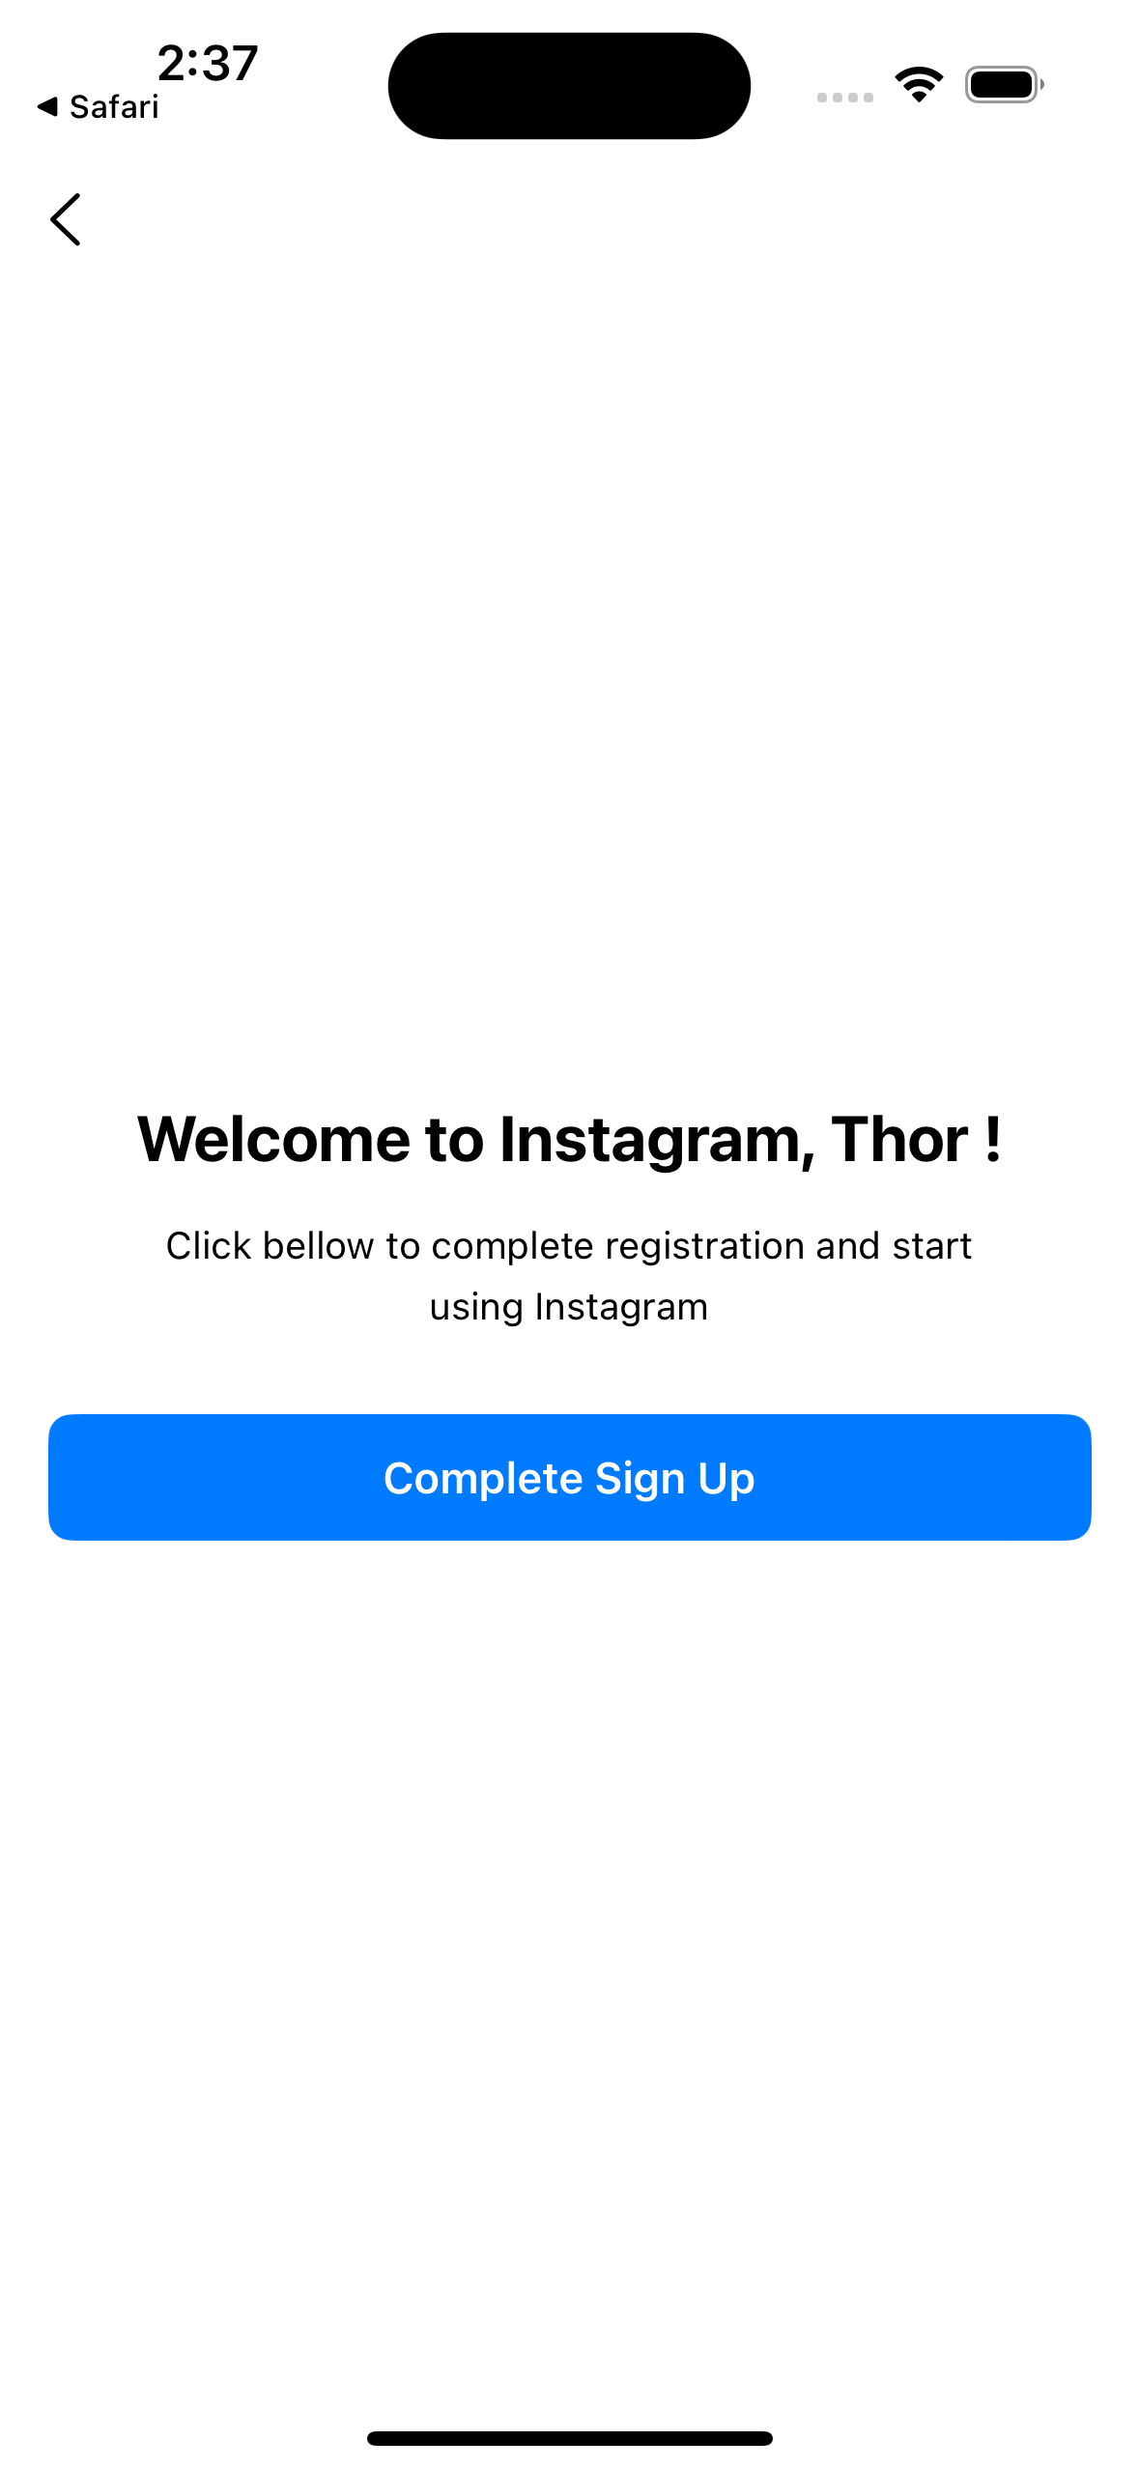
User Sign Up steps

Slide 6
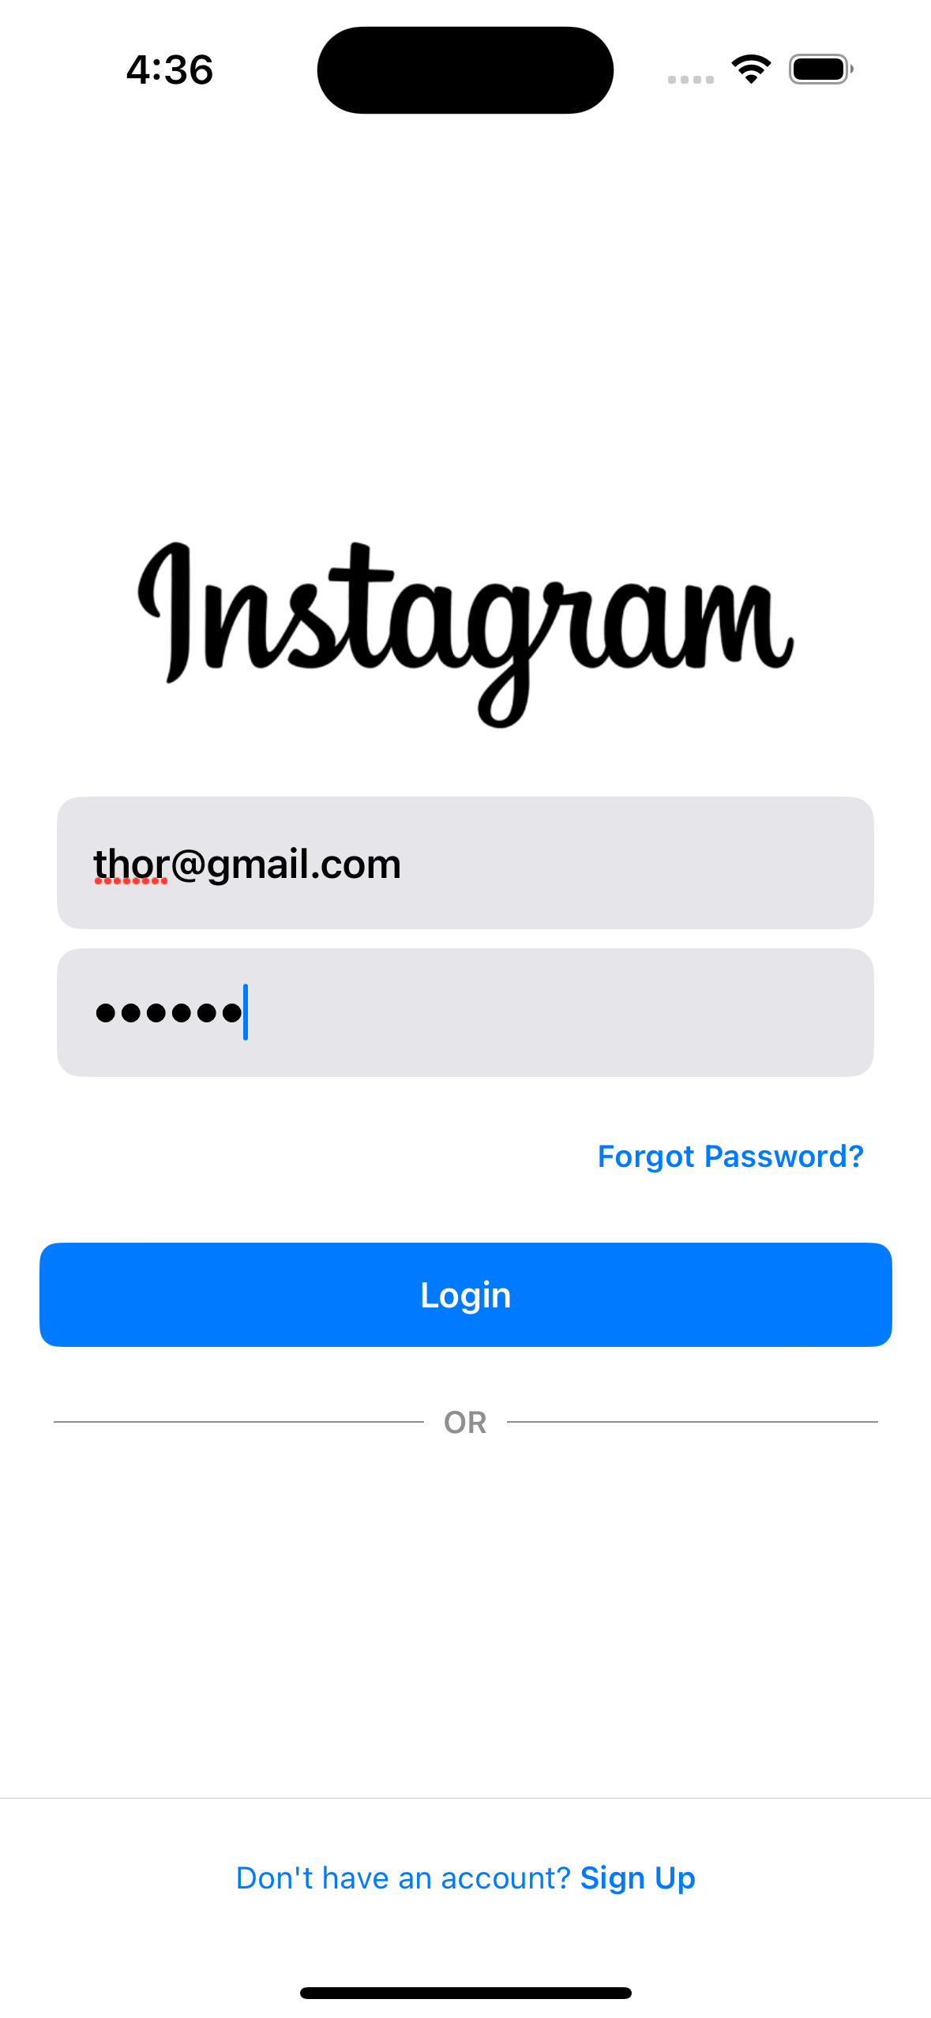
User LogIn
The user log-in feature is implemented using Firebase Authentication.
Users can log in by entering their email and password.
Once authenticated, they are redirected to the home screen

Slide 7
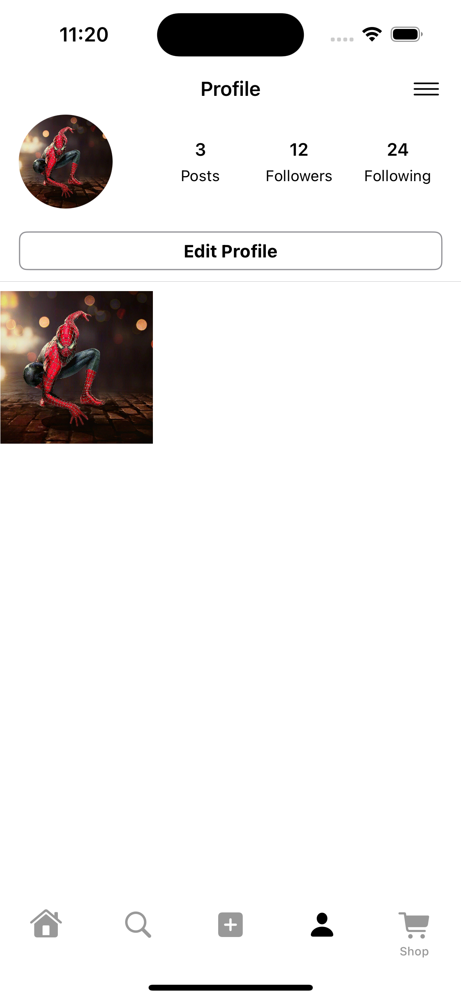
User Profile
User profile feature allows users to view and manage their personal information.
Users can show their uploaded posts here. And Users can also log out from their profile whenever they want.

Slide 8
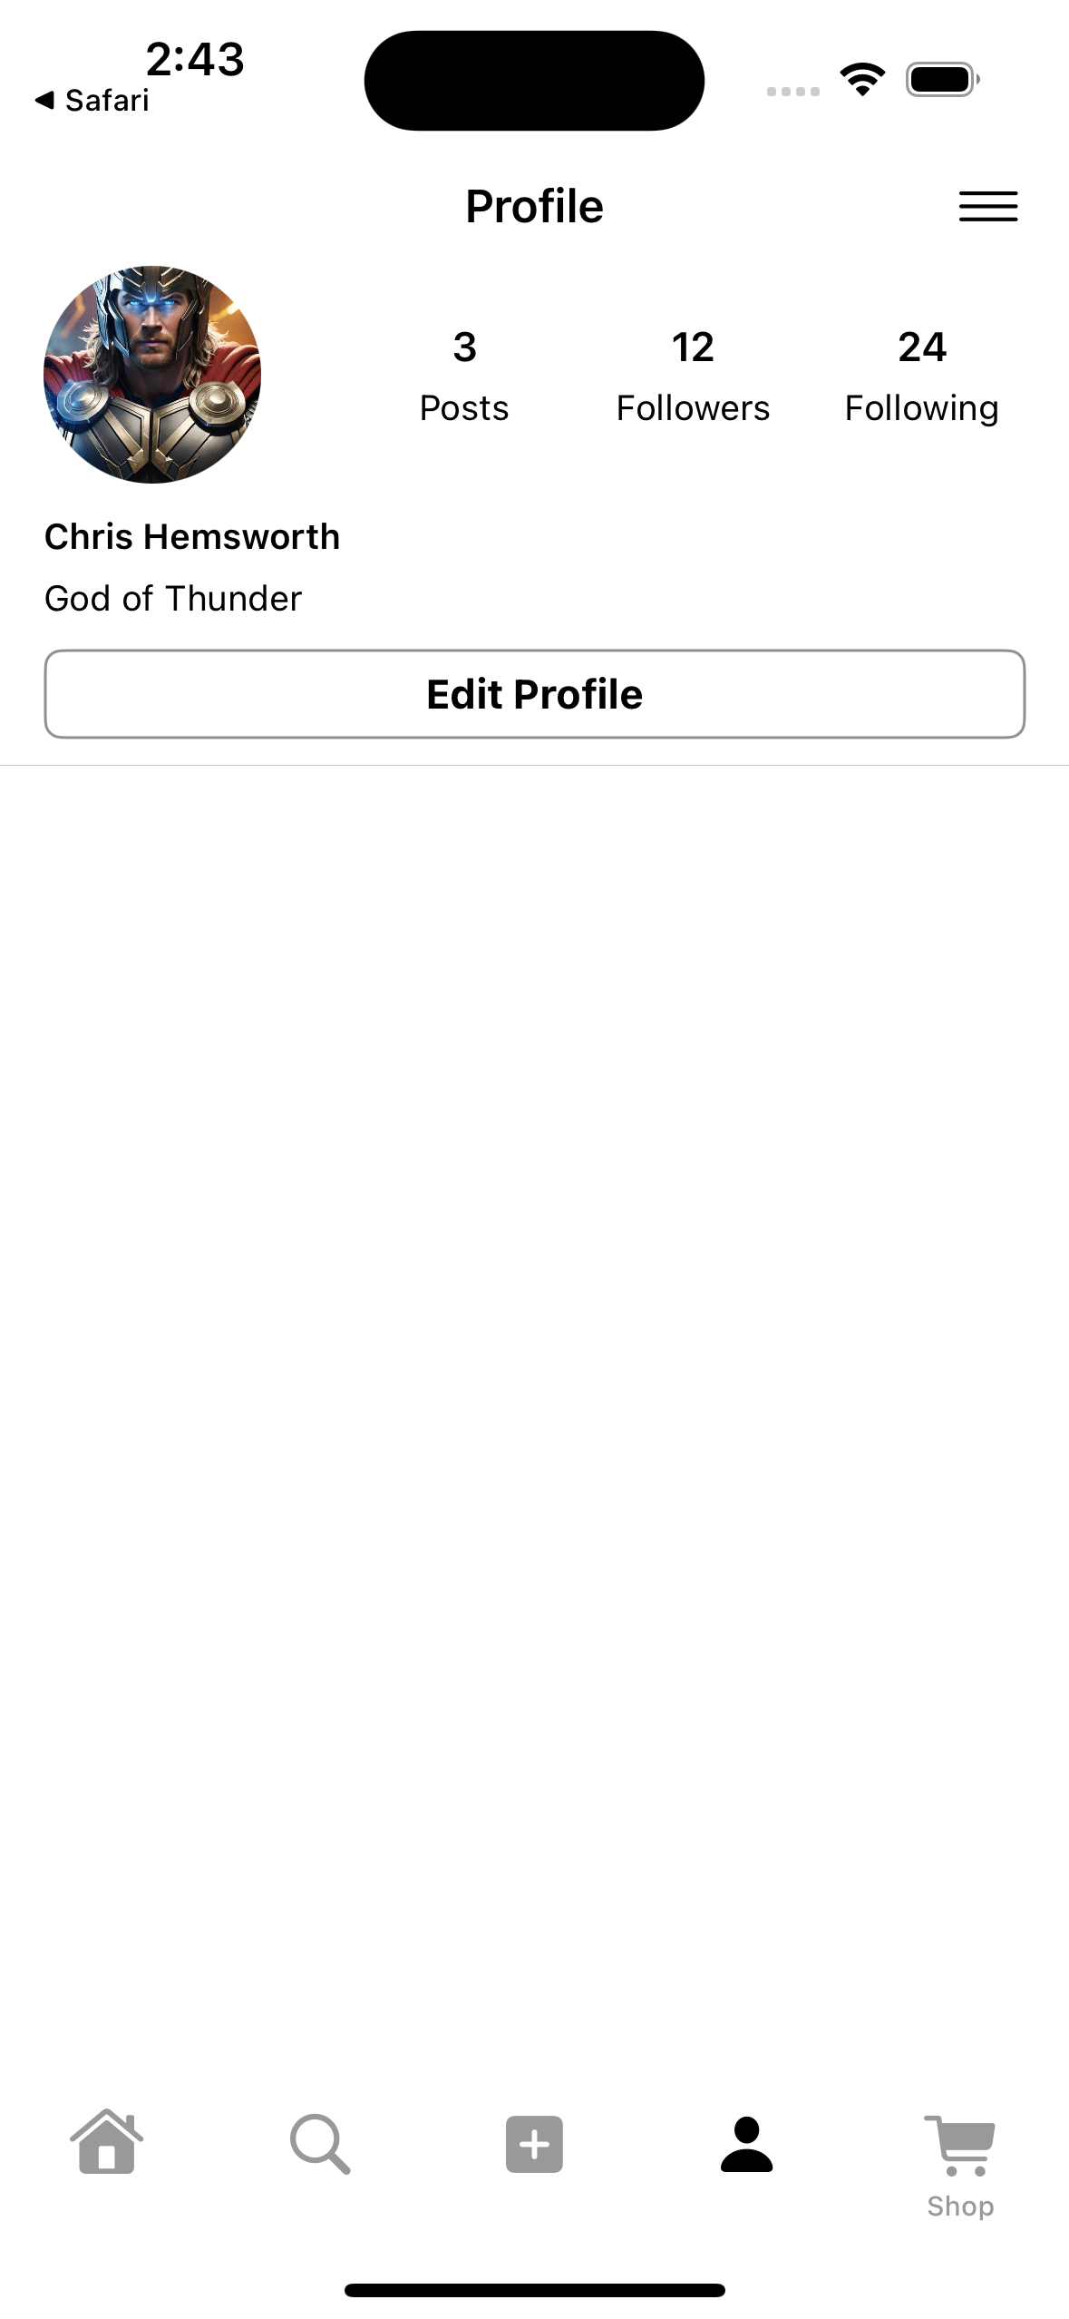
User Profile Edit
User Profile Edit feature allows users to Edit their Profile Data where they can change their name, update their profile picture and bio .
And all the changes are saved in Firebase database and Firebase storage.

Slide 9
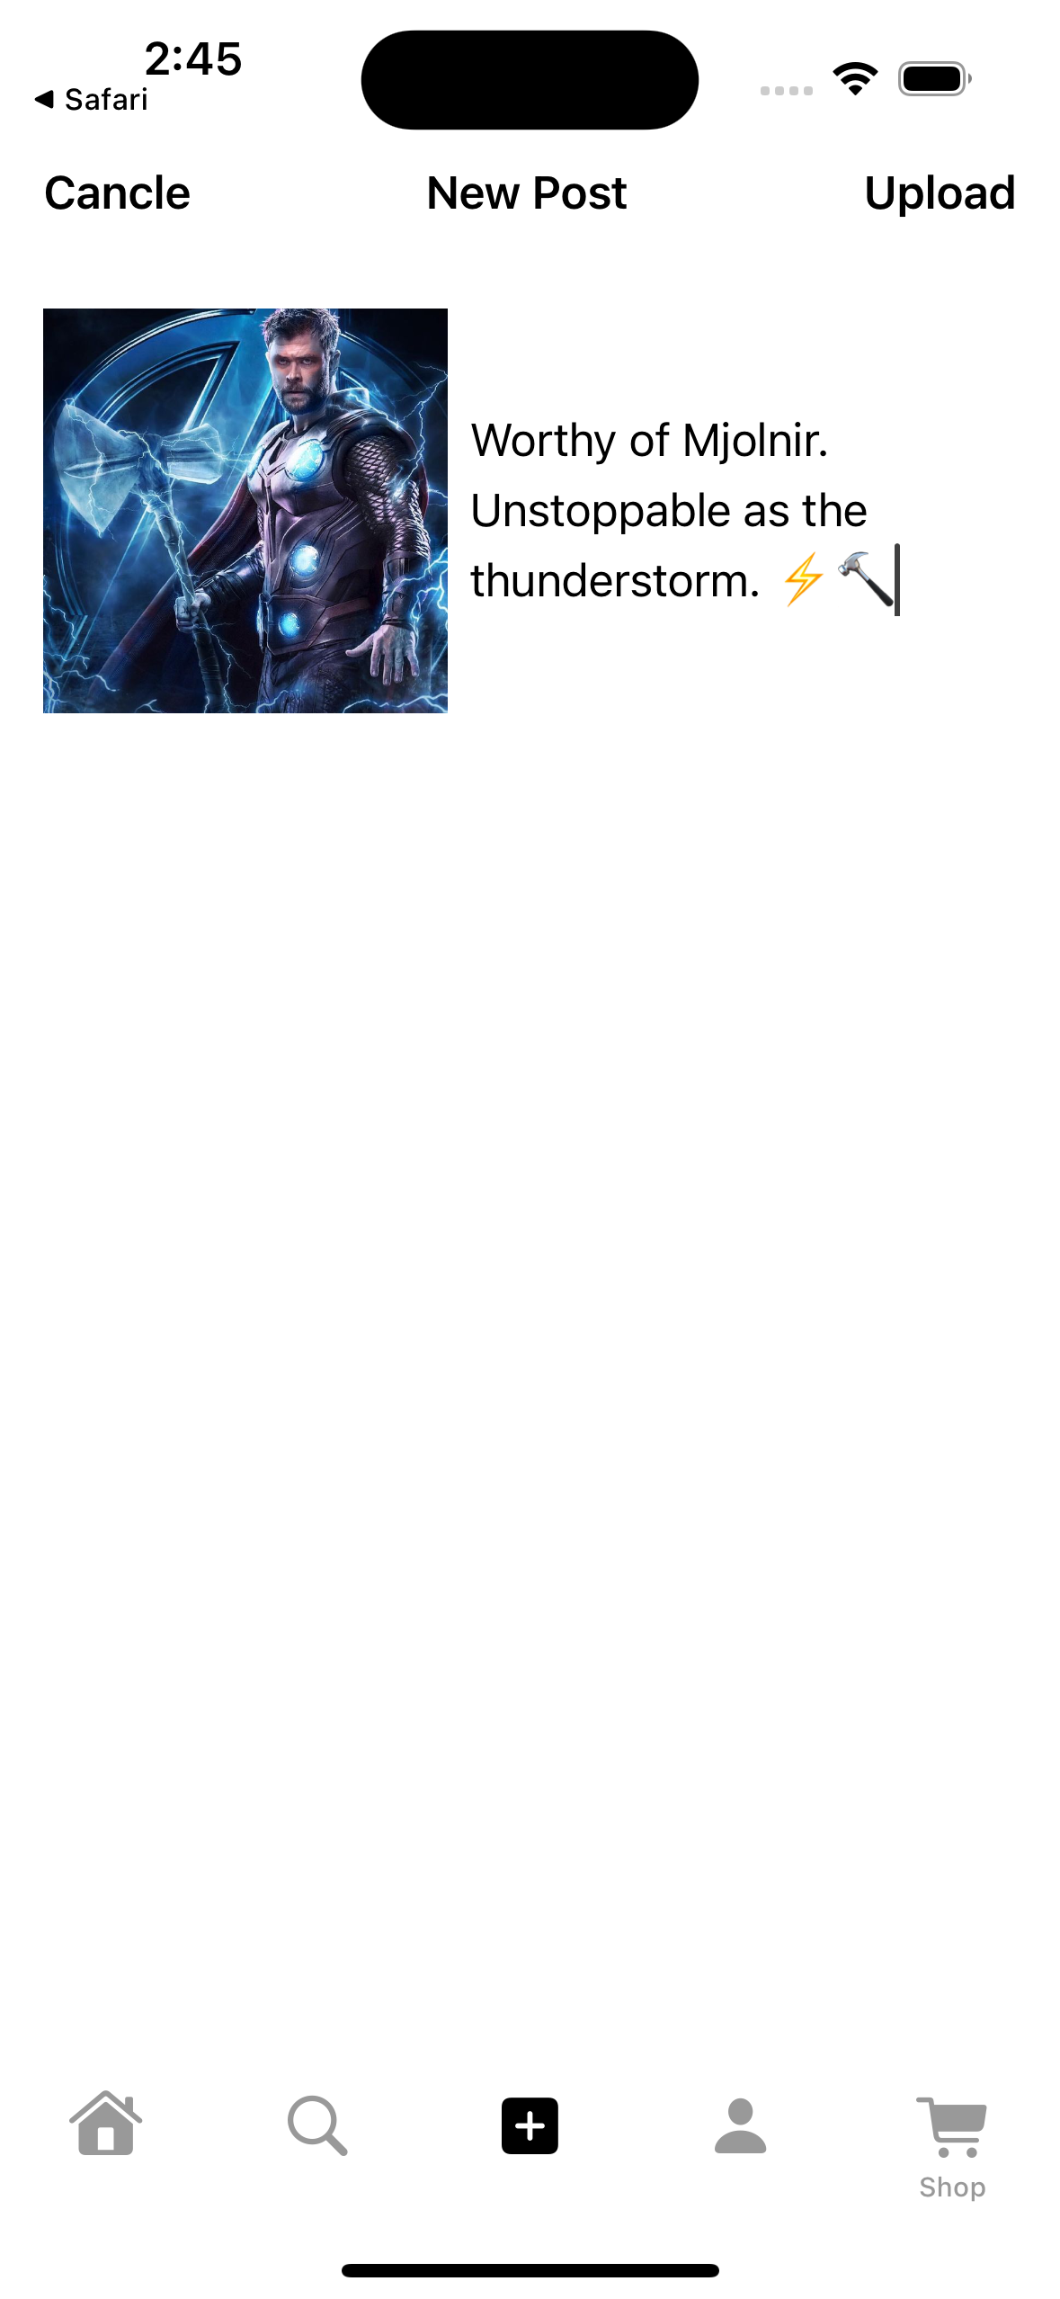
Upload Post
To upload a post, the user selects an image. Then add a caption and click "Upload" button.
The image is stored in Firebase Storage, and the post details are saved in Firebase database.
The post also appears in the user's feed for others to view.

Slide 10
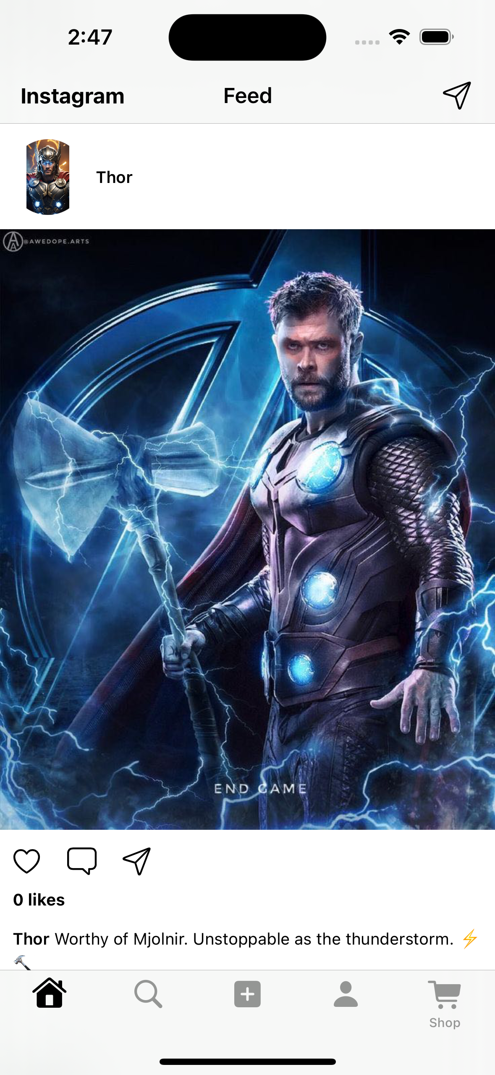
User Feed
User feed displays a list of posts from other users.
Each post contains an image and a caption. Users can scroll through the feed to view new content.
The feed is updated in real-time as new posts are uploaded.

Slide 11
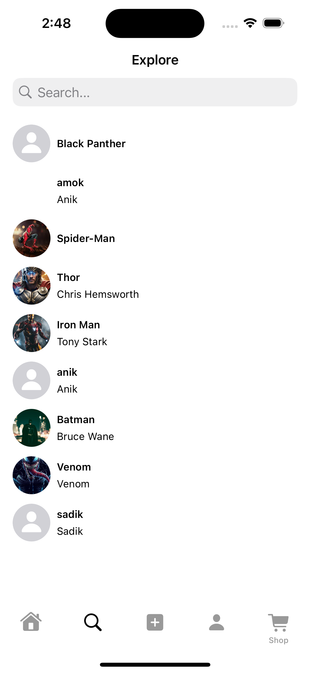
Search Option
Search option allows users to find specific users by entering keywords and then visit their profile.

Slide 12
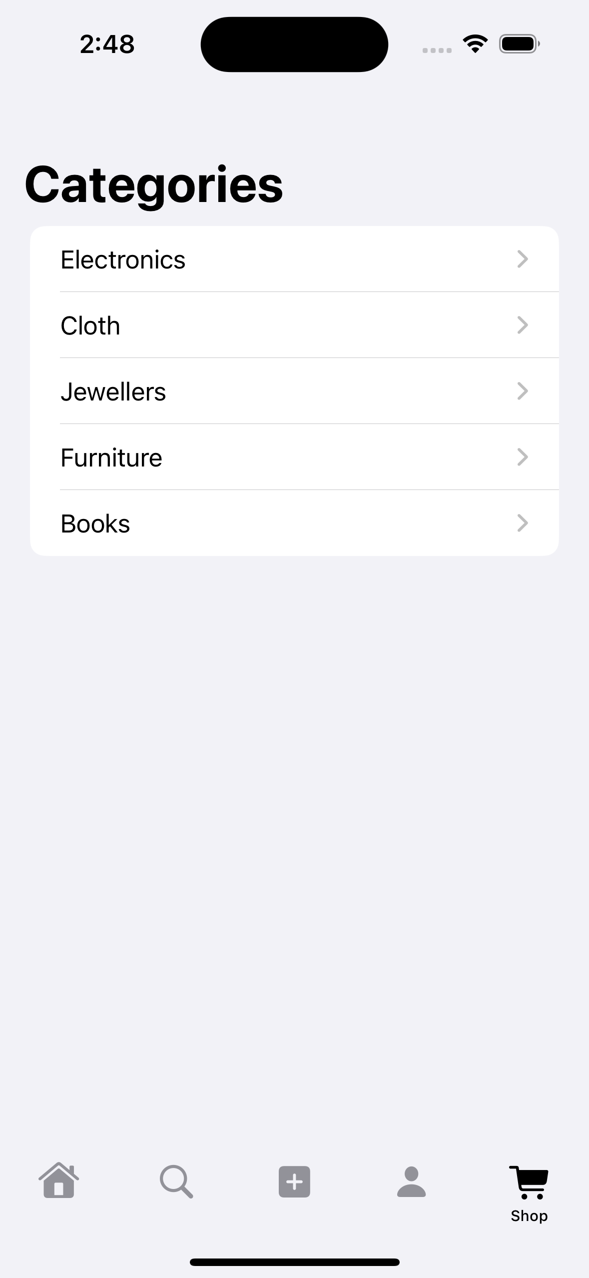
Shop List
For this project, I designed a structured JSON API to organize and display product data in our ios app.
The API includes categories like Electronics, Clothing, Jewelry, Furniture, and Books.
Each item contains key details such as name, image URL, post date, description, seller information, and contact number.

Slide 13
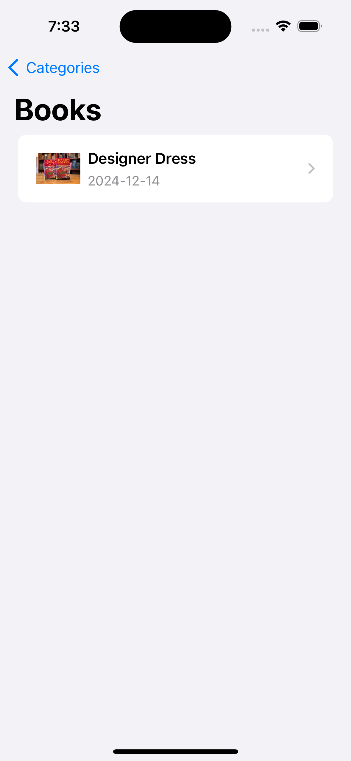
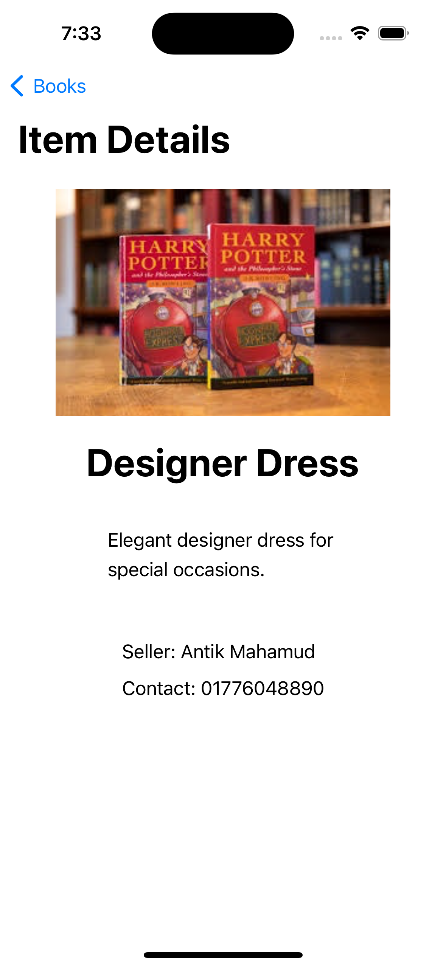
This API allows the app to dynamically fetch and display categorized products on the shop page, ensuring a smooth and user-friendly shopping experience.

Slide 14
Thank you

